Slide 1
An ESN approach for audio classification in construction sites
Edoardo Bini, Marco Ferraro, Alessandro Giannetti

Slide 2
OVERVIEW
INTRODUCTION
USE OF ESN
IMPLEMENTATION
RESULTS
introduction to paper and state of the art
description of the approach used and the role of the ESN
choices for the detection
results obtained

Slide 3


MACHINERY AUDIO
AUDIO SENSORS
AUDIO RECOGNITION
INTRODUCTION
INTRODUCTION
USE OF ESN
IMPLEMENTATION
RESULTS
Construction vehicles and tools
environmental microphones, microphones placed on vehicles and inside them
through an Echo State Network

Slide 4
PURPOSE OF THE PROJECT
Implement a Recurrent Neural Network (RNN) to classify active machinery in construction sites. In detail an Echo State Network.
INTRODUCTION
USE OF ESN
IMPLEMENTATION
RESULTS

Slide 5

WHAT IS AN ESN?
ECHO STATE NETWORK
Develop efficient learning algorithm solving RNN, signal processing and machine learning problems
An important component are the reservoirs. It can serve as a memory, providing temporal context. Is defined as $\left(W^{in},W, α\right):$
The input and the recurrent connection matrices are generated randomly according to some parameters
INTRODUCTION
USE OF ESN
IMPLEMENTATION
RESULTS

Slide 6
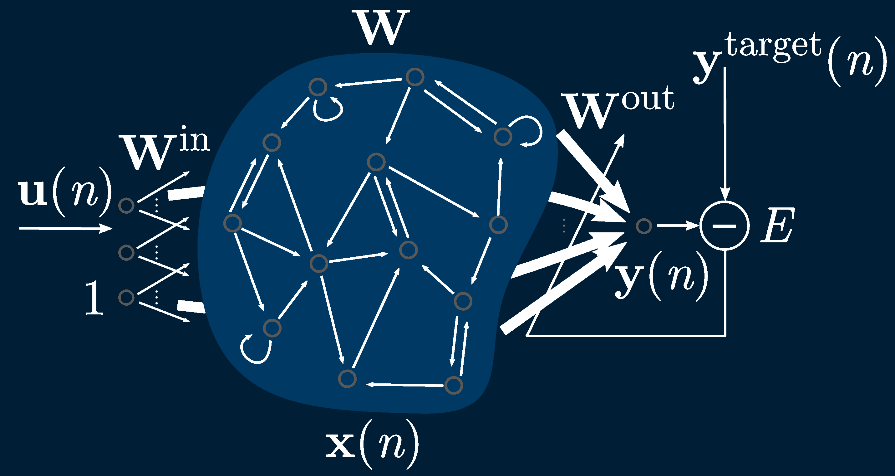

WHAT IS AN ESN?
RESERVOIR
Defined as $\left(W^{in},W, α\right):$ The input and the recurrent connection matrices are generated randomly according to this parameters:
Distr. of nonzero elem.
Size $N_{x}$
Sparsity
Spectral radius $W$
Scaling of $W^{in}$
Leaking rate
INTRODUCTION
USE OF ESN
IMPLEMENTATION
RESULTS
Echo State Network

Slide 7

HOW DO ESNs WORK?
Generate a Large random Reservoir RNN $\left(W^{in},W, α\right)$
Run it using the training input and collect the reservoir activation states
Compute the linear readout weights
Use the trained network on new input data employing the trained output weights
INTRODUCTION
USE OF ESN
IMPLEMENTATION
RESULTS

Slide 8
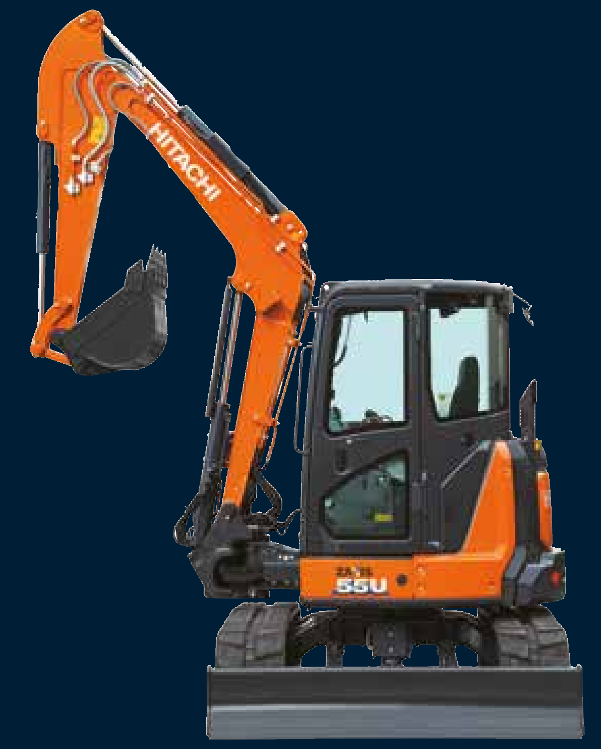
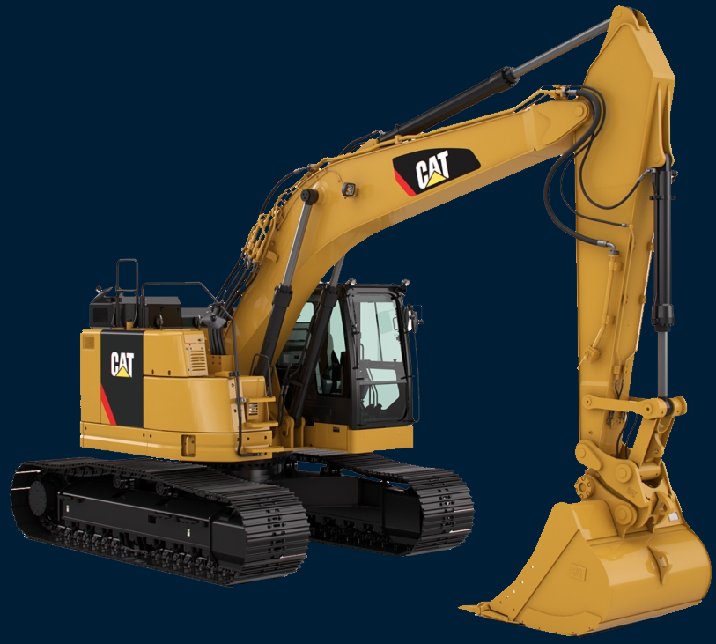
DATASET
UTAH AUDIO DATA
Audio collected from different construction machines and equipment from workers
Real working scenarios – background noises
Classes selected:
Backhoe JD50D Compact492
Compactor Ingersoll Rand
Concrete Mixer
Excavator Cat 320E
Excavator Hitachi 50U
INTRODUCTION
USE OF ESN
IMPLEMENTATION
RESULTS

Slide 9
DATASET
PREPROCESSING
Split each audio file into 30 ms segments
Discard segments under the average signal power by computing the Root Mean Square (mostly silent segments)
INTRODUCTION
USE OF ESN
IMPLEMENTATION
RESULTS

Slide 10
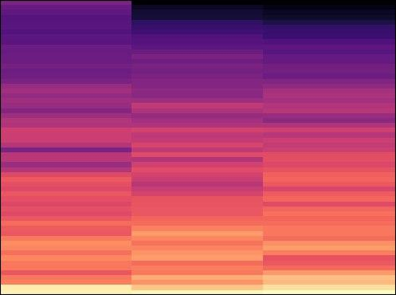
DATASET
PREPROCESSING
Generation of log-scaled mel-spectrogram from the waveform of the audio tracks with a sampling of 44100 Hz [Librosa python library]
INTRODUCTION
USE OF ESN
IMPLEMENTATION
RESULTS
Example of mel-spectrogram

Slide 11
INPUT DATA ELABORATION
Input of the ESN is a Numpy array concatenating the values of the three-time buckets of the spectrogram, one mel-band at a time
The labels corresponding to each segment consist of the one-hot-encoding of the specific class, also in Numpy array
INTRODUCTION
USE OF ESN
IMPLEMENTATION
RESULTS

Slide 12

MEMORY USAGE
EasyESN (Like most available ESN libraries) load the entire training dataset into memory before starting the training process
Our training was forced into a trade-off between sizes of training data and the reservoir
POSSIBLE SOLUTION FOR FUTURE WORK
Custom-made ESN with batch training
Use dedicated large memory hardware
INTRODUCTION
USE OF ESN
IMPLEMENTATION
RESULTS

Slide 13
IMPLEMENTATIVE CHOICES
EasyESN Python library
Empirically found the best parameters for the ESN:
300 audio segments for each class (1500 audio samples for the training set)
Reservoir size of 1200
Leaking rate of 0.1
INTRODUCTION
USE OF ESN
IMPLEMENTATION
RESULTS

Slide 14
GRAPHICAL RESULTS
PRECISION
RECALL
F1 - SCORE
Backhoe JD50DCompact
Compactor Ingersoll Rand
Concrete Mixer
Test on 150000 audio segments (300 for each class)
Excavator CAT320E
Excavator Hitachi50U
0.75
0.79
INTRODUCTION
0.88
USE OF ESN
0.82
0.88
IMPLEMENTATION
0.87
ACCURACY | 81.92%
AVERAGE PRECISION | 82.48%
AVERAGE RECALL | 81.92%
AVERAGE F1-SCORE | 0.8185
DETECTION TIME [30ms] | 45 ms
RESULTS
0.84
0.83
0.87
0.69
0.81
0.81
0.85
0.84
0.78
0
0.3
0.6
0.7
0.8
0.9
Notes:
As mentioned earlier by Marco we have trained the model with 300 segments for each class, for a total of one thousand and five hundred audio samples and it only took a minute and a half.
After training the classification model, we tested its performance metrics on one hundred and fifty thousand audio segments :
In this graph we have a view on the values of precision, recall, and f1-score of the single classes, and as we can see that class in orange that is the Backhoe and dark red that is the Hitachi are the ones who had the most trouble to being recognized.
in the table on the right we have the average values and accuracy of all the classes.
We obtained an overall accuracy of about 82%, an average precision of 82.48%, an average recall of about 82% (equal to the overall accuracy since the data-set is perfectly balanced) and an average F1-score of 0,8185 .
We found that the processing time for each segment is 45ms with our machine, but with some optimization it can be a real time classification application.

Slide 15
CONFUSION MATRIX
 | Backhoe JD50DCompact | Compactor Ingersoll Rand | Concrete Mixer | Excavator CAT320E | Excavator Hitachi50U
Backhoe JD50DCompact | 26019 | 541 | 204 | 1157 | 2169
Compactor Ingersoll Rand | 572 | 25119 | 1903 | 2214 | 192
Concrete Mixer | 269 | 3217 | 24977 | 1376 | 134
Excavator CAT320E | 1597 | 954 | 1185 | 26004 | 260
Excavator Hitachi50U | 6047 | 2123 | 258 | 810 | 20762
INTRODUCTION
USE OF ESN
IMPLEMENTATION
RESULTS
Notes:
Thanks to the confusion matrix we can see in detail the classes that have been misclassified.
[click] we have highlighted in red the classes that have been misclassified more than 2000 times with one other class in particular
[click] We can see that the Excavator Hitachi50U class was confused the most with Backhoe JD50DCompact . In fact 6047 segments containing audio from the Excavator Hitachi50U were classified as Backhoe JD50DCompact.
This may be due both to the similarity between the sound emitted by the two machines, but also to the possible poor quality of the samples present in the dataset.

Slide 16
POST-PROCESSING
MAJORITY VOTING
Augment the capabilities of the classifier implementing a majority voting system
~0,5 Seconds (17 segments)
~1 Second (34 segments)
~2 Seconds (67 segments)
~3 Seconds (100 segments)
INTRODUCTION
USE OF ESN
IMPLEMENTATION
RESULTS
Notes:
Due to the problems we encountered in managing the ESN in terms of memory, and since we were not able to increase the ms of the segments or use a batch system for the data, we decided to manage a post processing on the data obtained from the detection.
We decided to implement a majority voting system.
majority voting is simply taking a block of values as input and returning the most recurring value as a result.
We decided to test it on blocks of 17, 24, 67, and 100 segments to evaluate the performance.

Slide 17
MAJORITY VOTING
INTRODUCTION
USE OF ESN
IMPLEMENTATION
RESULTS
Notes:
In practice, as we can see schematically, we take the above values, and based on the blocks considered for majority voting we return the most recurring value as a result.
[click] here we have the 17 segments
[click] the 34 segments and so on [click]
Given that the classifier evaluates the audio every 30 ms, if we implement a majority voting system, we will have to wait for multiple audio segments to be classified before we can make a prediction. In non-instantaneous applications, for example, it may be possible to classify data after a few seconds, and even in the case of instant applications, a small delay of 500 ms may be acceptable. For this reason, we decided to try it to see the results

Slide 18
MAJORITY VOTING
Backhoe JD50DCompact
Compactor Ingersoll Rand
Concrete Mixer
~0.5 SECOND (17 SEGMENTS)
Excavator CAT320E
Excavator Hitachi50U
0.82
PRECISION
0.91
INTRODUCTION
0.97
USE OF ESN
0.94
0.98
IMPLEMENTATION
ACCURACY | 91.9%
AVERAGE PRECISION | 92.5%
AVERAGE RECALL | 91.9%
AVERAGE F1-SCORE | 0.918
RESULTS
0.97
0.94
RECALL
0.96
0.94
0.80
0.89
0.82
F1 - SCORE
0.96
0.94
0.88
0
0.3
0.6
0.7
0.8
0.9
1
Notes:
Moving on to the results obtained with the mojority voting we can see that with 17 segments we have an increase of about 10% on both accuracy, precision and recall.

Slide 19
MAJORITY VOTING
Backhoe JD50DCompact
Compactor Ingersoll Rand
Concrete Mixer
~1 SECOND (34 SEGMENTS)
Excavator CAT320E
Excavator Hitachi50U
0.84
PRECISION
0.94
INTRODUCTION
0.98
USE OF ESN
0.96
0.99
IMPLEMENTATION
ACCURACY | 93.7%
AVERAGE PRECISION | 94.2%
AVERAGE RECALL | 93.7%
AVERAGE F1-SCORE | 0.936
RESULTS
0.99
0.95
RECALL
0.98
0.95
0.82
0.90
0.95
F1 - SCORE
0.98
0.95
0.90
0
0.3
0.6
0.7
0.8
0.9
1
Notes:
By increasing the number of segments, we can see how the rates are gradually increasing.
With 34 segments we had an increase of about 2% on all parameters compared with the 17 segments, with a total increase of 12%.

Slide 20
MAJORITY VOTING
Backhoe JD50DCompact
Compactor Ingersoll Rand
Concrete Mixer
~2 SECOND (67 SEGMENTS)
Excavator CAT320E
Excavator Hitachi50U
0.86
PRECISION
0.96
INTRODUCTION
0.99
USE OF ESN
0.97
1
IMPLEMENTATION
ACCURACY | 95.26%
AVERAGE PRECISION | 95.72%
AVERAGE RECALL | 95.26%
AVERAGE F1-SCORE | 0.952
RESULTS
1
0.97
RECALL
0.99
0.96
0.85
0.92
0.97
F1 - SCORE
0.99
0.96
0.91
0
0.3
0.6
0.7
0.8
0.9
1
Notes:
While Using 67 segments, corresponding to 2 seconds of audio, we achieved the best results for each individual class, with a further increase of almost 2% on all the parameters, for a total of 14%.

Slide 21
MAJORITY VOTING
Backhoe JD50DCompact
Compactor Ingersoll Rand
Concrete Mixer
3 SECOND (100 SEGMENTS)
Excavator CAT320E
Excavator Hitachi50U
0.86
PRECISION
0.97
INTRODUCTION
0.99
USE OF ESN
0.97
1
IMPLEMENTATION
ACCURACY | 95.26%
AVERAGE PRECISION | 95.74%
AVERAGE RECALL | 95.27%
AVERAGE F1-SCORE | 0.952
RESULTS
1
0.96
RECALL
0.99
0.96
0.84
0.92
0.96
F1 - SCORE
0.99
0.97
0.92
0
0.3
0.6
0.7
0.8
0.9
1
Notes:
Regarding the 100 segments the increase in benefits was smaller than in the previous case.
Because there are a lot of consecutive detection error majority voting starts to shows smaller and smaller gains with an increase of segments.
I want to stress that all these results are indicative of a better performance for majority voting, but do not guarantee statistical evidence because the amount of samples is not large enough.

Slide 22
CONCLUSION
ESNs demonstrated a remarkable versatility by showing their potential in the audio recognition field
Unlike CNN it has worse performance, but it is easier to set up and much faster to train.
INTRODUCTION
USE OF GAN
IMPLEMENTATION
RESULTS
Notes:
In conclusion ESNs demonstrated a remarkable versatility by showing their potential in the audio data recognition field.
In comparison with a CNN the ESN has a worse performance, also due to the limitations we've had with the memories, but it is easier to set up and much faster to train.

Slide 23
THANK YOU For your attention

